Slide 1
Architecture of Enterprise Applications 23 Container
Haopeng Chen
REliable, INtelligent and Scalable Systems Group (REINS)
Shanghai Jiao Tong University
Shanghai, China
http://reins.se.sjtu.edu.cn/~chenhp
e-mail: chen-hp@sjtu.edu.cn

Slide 2
Contents and Objectives
Container
Docker
Develop Applications with Docker
Objectives
能够根据系统容器化部署的需求，将本地应用迁移到云中容器集群中进行部署

Slide 3
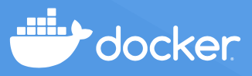
Docker
What is a Container? https://www.docker.com
A container is a sandboxed process running on a host machine that is isolated from all other processes running on that host machine.
That isolation leverages kernel namespaces and cgroups, features that have been in Linux for a long time.
Docker makes these capabilities approachable and easy to use. To summarize, a container:
Is a runnable instance of an image. You can create, start, stop, move, or delete a container using the Docker API or CLI.
Can be run on local machines, virtual machines, or deployed to the cloud.
Is portable (and can be run on any OS).
Is isolated from other containers and runs its own software, binaries, configurations, etc.
If you're familiar with chroot, then think of a container as an extended version of chroot.
The filesystem comes from the image. However, a container adds additional isolation not available when using chroot.

Slide 4
Docker
What is an Image? https://www.docker.com
A running container uses an isolated filesystem.
This isolated filesystem is provided by an image, and the image must contain everything needed to run an application - all dependencies, configurations, scripts, binaries, etc.
The image also contains other configurations for the container, such as environment variables, a default command to run, and other metadata.

Slide 5
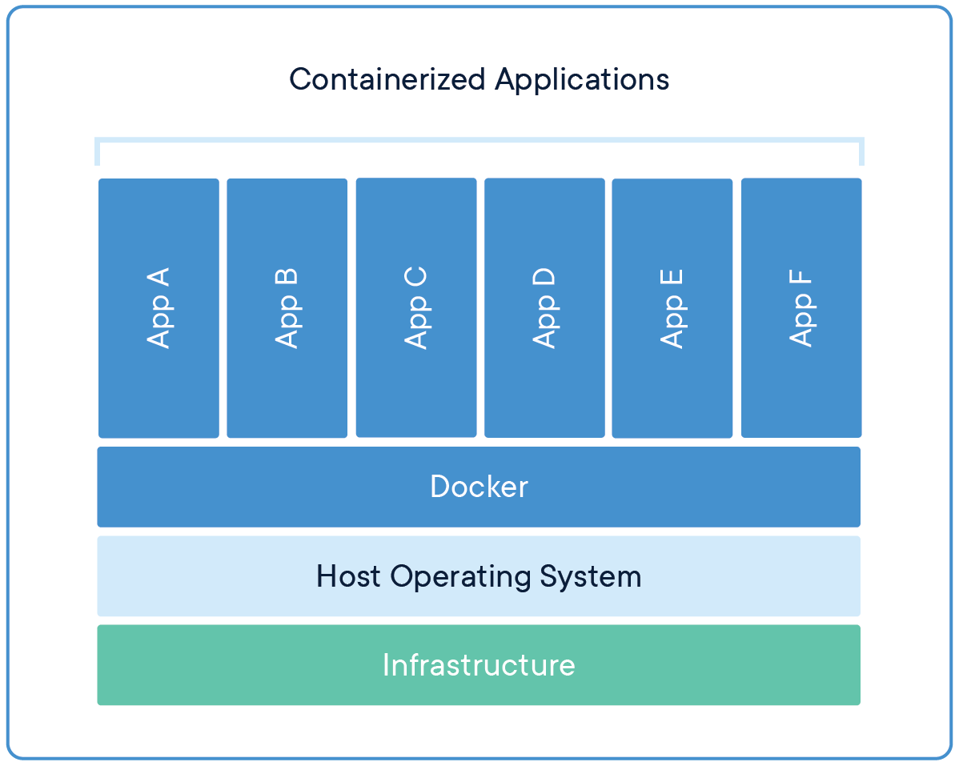
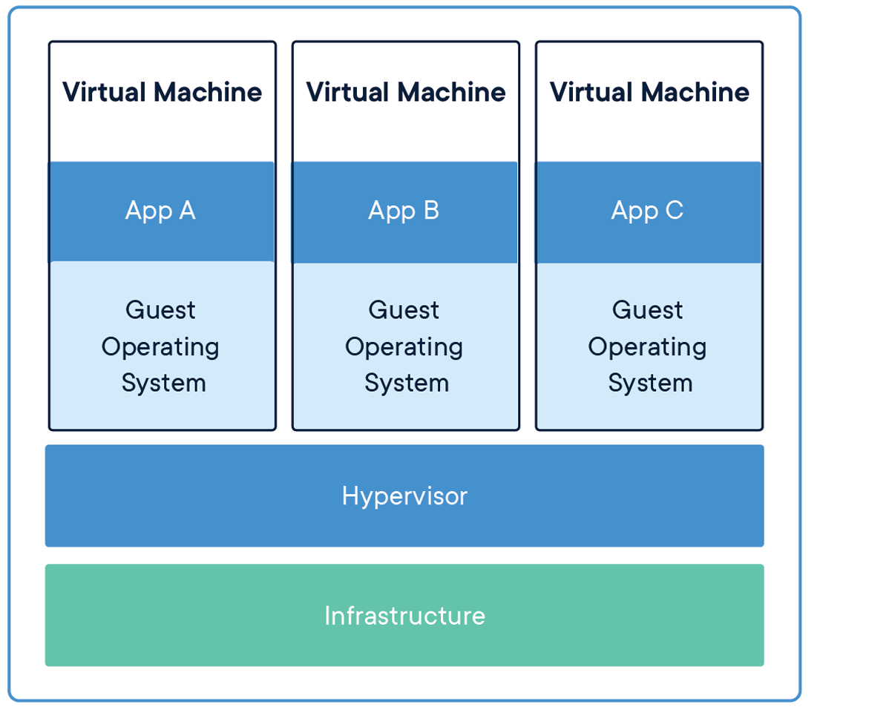
Comparing Containers and Virtual Machines
Containers and virtual machines have similar resource isolation and allocation benefits,
but function differently because containers virtualize the operating system instead of hardware. Containers are more portable and efficient.

Slide 6

Docker Architecture
Docker uses a client-server architecture

Slide 7
The underlying technology
Docker is written in the Go programming language and
takes advantage of several features of the Linux kernel to deliver its functionality.
Docker uses a technology called namespaces to provide the isolated workspace called the container.
When you run a container, Docker creates a set of namespaces for that container.
These namespaces provide a layer of isolation.
Each aspect of a container runs in a separate namespace and its access is limited to that namespace.

Slide 8
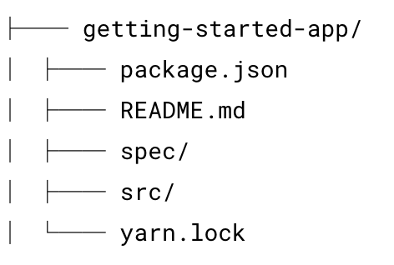
Containerize application
From: https://docs.docker.com/get-started/
Get the app
git clone https://github.com/docker/getting-started-app.git
https://github.com/docker/getting-started-app/tree/main

Slide 9
Containerize application
Build the app’s image
To build the image, you'll need to use a Dockerfile. A Dockerfile is simply a text-based file with no file extension that contains a script of instructions. Docker uses this script to build a container image.
Create a file named Dockerfile in the same folder as the file package.json with the following contents.
# syntax=docker/dockerfile:1
FROM node:18-alpine
WORKDIR /app
COPY . .
RUN yarn install --production
CMD ["node", "src/index.js"]
EXPOSE 3000
Now build the container image using the docker build command.
docker build -t getting-started .

Slide 10
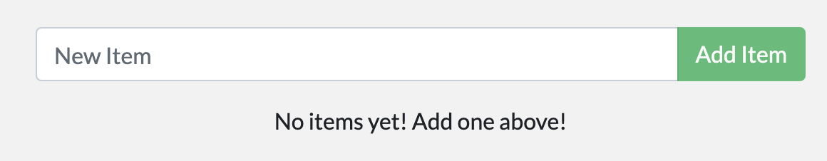
Containerize application
Start an app container
Start your container using the docker run command and specify the name of the image we just created:
docker run -dp 3000:3000 getting-started
The -d flag (short for --detach) runs the container in the background.
The -p flag (short for --publish) creates a port mapping between the host and the container.
The -p flag takes a string value in the format of HOST:CONTAINER, where HOST is the address on the host, and CONTAINER is the port on the container.
The command publishes the container's port 3000 to 127.0.0.1:3000 (localhost:3000) on the host. Without the port mapping, you wouldn't be able to access the application from the host.
After a few seconds, open your web browser to http://localhost:3000.

Slide 11
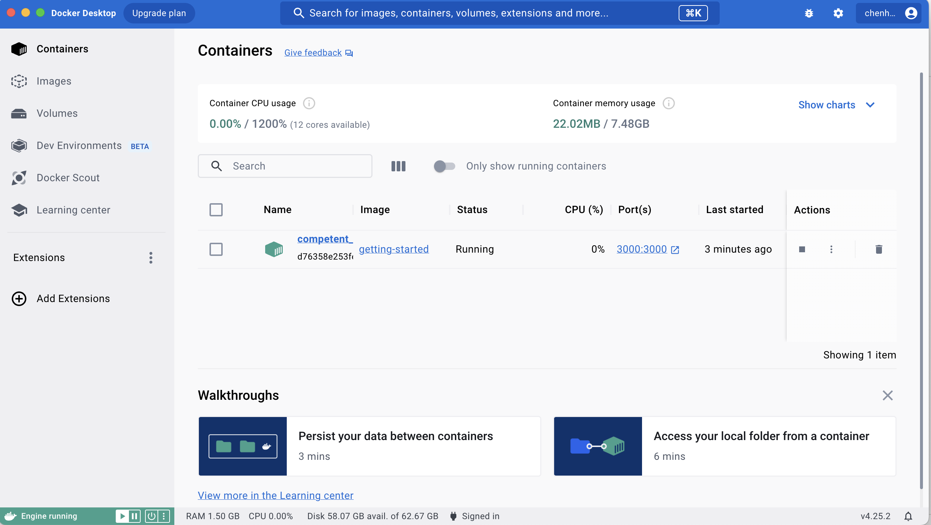
Containerize application
Start an app container
Take a quick look at the Docker Dashboard.

Slide 12
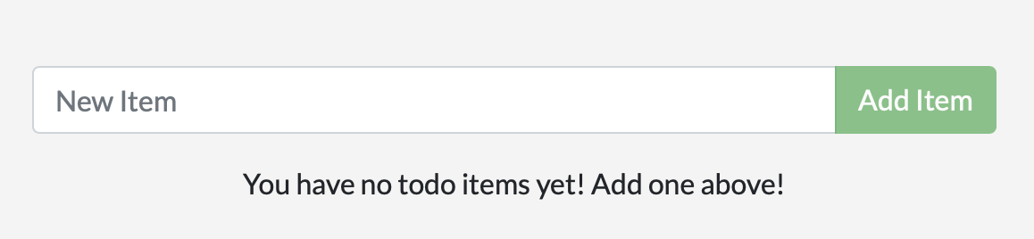
Update the application
Update the source code
In the src/static/js/app.js file, update line 56 to use the new empty text.
- <p className="text-center">No items yet! Add one above!</p>
+ <p className="text-center">You have no todo items yet! Add one above!</p>
Let’s build our updated version of the image, using the same command we used before.
$ docker build -t getting-started .
Let’s start a new container using the updated code.
$ docker run -dp 3000:3000 getting-started

Slide 13
Update the application
Remove a container using the CLI
Get the ID of the container by using the docker ps command.
$ docker ps
Use the docker stop command to stop the container.
# Swap out <the-container-id> with the ID from docker ps
$ docker stop <the-container-id>
Once the container has stopped, you can remove it by using the docker rm command.
$ docker rm <the-container-id>
Start the updated app container
Now, start your updated app.
$ docker run -dp 3000:3000 getting-started

Slide 14
Share the application
To share Docker images, you have to use a Docker registry.
The default registry is Docker Hub and is where all of the images we’ve used have come from.
Create a repo
To push an image, we first need to create a repository on Docker Hub.
Push the image
Use the docker tag command to give the getting-started image a new name. Be sure to swap out YOUR-USER-NAME with your Docker ID.
docker tag getting-started YOUR-USER-NAME/getting-started
Now try your push command. If you’re copying the value from Docker Hub, you can drop the tagname portion, as we didn’t add a tag to the image name. If you don’t specify a tag, Docker will use a tag called latest.
docker push YOUR-USER-NAME/getting-started

Slide 15
Persist the DB
The container’s filesystem
When a container runs, it uses the various layers from an image for its filesystem.
Each container also gets its own “scratch space” to create/update/remove files.
Any changes won’t be seen in another container, even if they are using the same image.
To see this in action, we’re going to start two containers and create a file in each.
Start an ubuntu container that will create a file named /data.txt with a random number between 1 and 10000.
$ docker run -d ubuntu bash -c "shuf -i 1-10000 -n 1 -o /data.txt && tail -f /dev/null"
Start another ubuntu container.
$ docker run -it ubuntu ls /

Slide 16
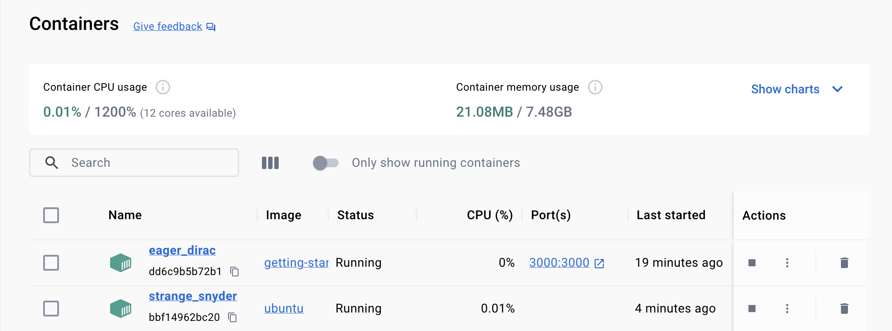
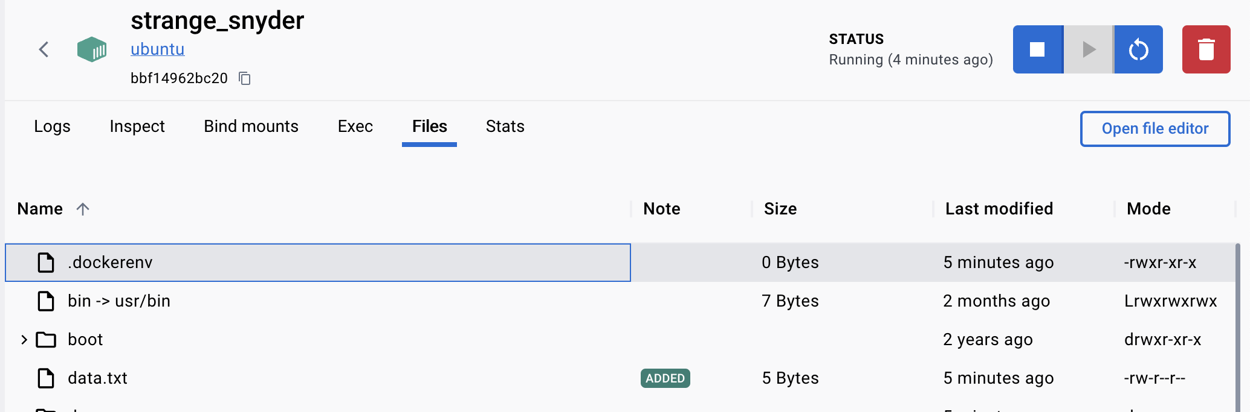
Persist the DB

Slide 17
Container Volume
With the previous experiment, we saw that each container starts from the image definition each time it starts.
While containers can create, update, and delete files, those changes are lost when the container is removed and all changes are isolated to that container.
With volumes, we can change all of this.
Volumes provide the ability to connect specific filesystem paths of the container back to the host machine.
If a directory in the container is mounted, changes in that directory are also seen on the host machine.
If we mount that same directory across container restarts, we’d see the same files.
There are two main types of volumes.
We will eventually use both, but we will start with named volumes.

Slide 18
Persist the todo data
By default, the todo app stores its data in a SQLite Database at /etc/todos/todo.db in the container’s filesystem.
With the database being a single file, if we can persist that file on the host and make it available to the next container, it should be able to pick up where the last one left off.
We are going to use a named volume.
Think of a named volume as simply a bucket of data.
Docker maintains the physical location on the disk and you only need to remember the name of the volume.
Every time you use the volume, Docker will make sure the correct data is provided.

Slide 19
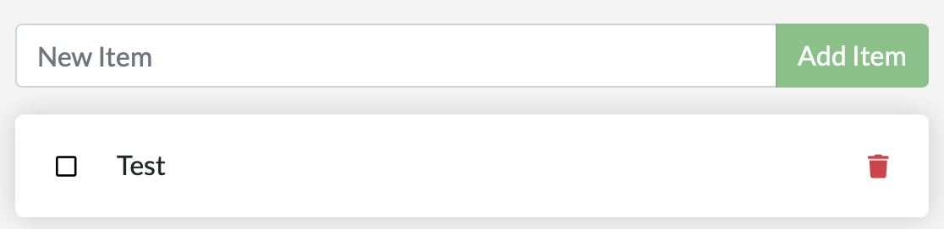
Persist the todo data
Create a volume by using the docker volume create command.
$ docker volume create todo-db
Stop and remove the todo app container once again in the Dashboard (or with docker rm -f <id>), as it is still running without using the persistent volume.
Start the todo app container, but add the -v flag to specify a volume mount.
We will use the named volume and mount it to /etc/todos, which will capture all files created at the path.
$ docker run -dp 127.0.0.1:3000:3000 --mount type=volume,src=todo-db,target=/etc/todos getting-started
Once the container starts up, open the app and add a few items to your todo list.

Slide 20
Persist the todo data
Stop and remove the container for the todo app.
Use the Dashboard or docker ps to get the ID and then docker rm -f <id> to remove it.
Start a new container using the same command from above.
Open the app. You should see your items still in your list!
Go ahead and remove the container when you’re done checking out your list.

Slide 21
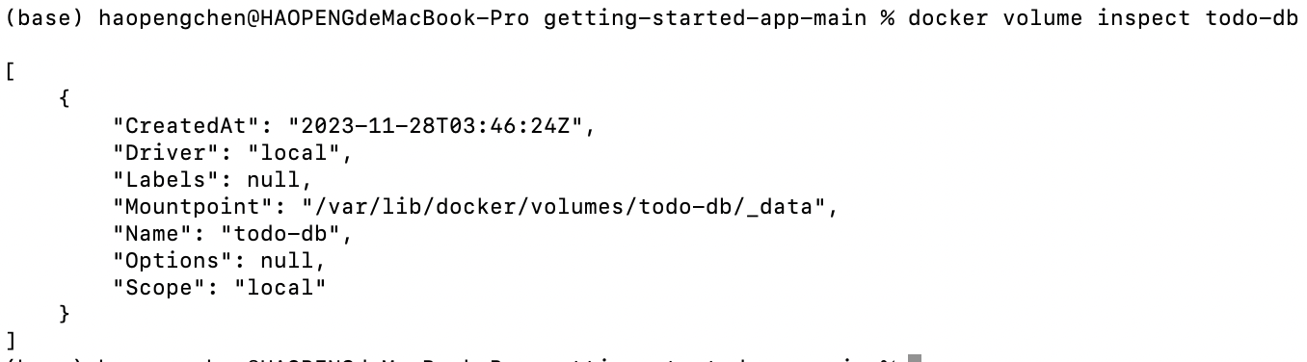
Dive into the volume
A lot of people frequently ask
“Where is Docker actually storing my data when I use a named volume?”
If you want to know, you can use the docker volume inspect command.
The Mountpoint is the actual location on the disk where the data is stored.
Note that on most machines, you will need to have root access to access this directory from the host. But, that’s where it is!
Notes:
docker volume inspect todo-db

Slide 22
Use bind mounts
With bind mounts, we control the exact mountpoint on the host.
We can use this to persist data, but it’s often used to provide additional data into containers.
When working on an application, we can use a bind mount to mount our source code into the container to let it see code changes, respond, and let us see the changes right away.
Bind mounts and named volumes are the two main types of volumes that come with the Docker engine.
However, additional volume drivers are available to support other uses cases (SFTP, Ceph, NetApp, S3, and more).

Slide 23
Use bind mounts
 | Named volumes | Bind mounts
Host location | Docker chooses | You decide
Mount example (using --mount) | type=volume, src=my-volume, target=/usr/local/data | type=bind, src=/path/to/data, target=/usr/local/data
Populates new volume with container contents | Yes | No
Supports Volume Drivers | Yes | No

Slide 24
Trying out bind mounts
Verify that your getting-started-app directory is in a directory defined in Docker Desktop's file sharing setting.
This setting defines which parts of your filesystem you can share with containers.
Open a terminal and change directory to the getting-started-app directory.
Run the following command to start bash in an ubuntu container with a bind mount.
$ docker run -it --mount type=bind,src="$(pwd)",target=/src ubuntu bash
After running the command, Docker starts an interactive bash session in the root directory of the container's filesystem.
root@ac1237fad8db:/# pwd
/
root@ac1237fad8db:/# ls
bin dev home media opt root sbin srv tmp var
boot etc lib mnt proc run src sys usr

Slide 25
Trying out bind mounts
Change directory to the src directory.
root@ac1237fad8db:/# cd src
root@ac1237fad8db:/src# ls
Dockerfile node_modules package.json spec src yarn.lock
Create a new file named myfile.txt.
root@ac1237fad8db:/src# touch myfile.txt
root@ac1237fad8db:/src# ls
Dockerfile myfile.txt node_modules package.json spec src yarn.lock

Slide 26
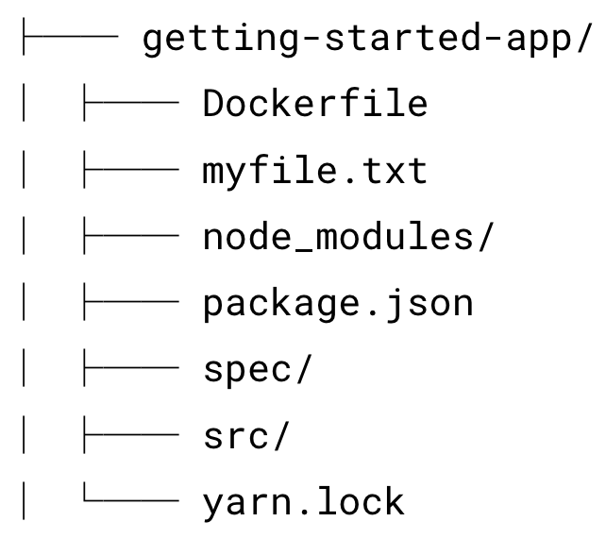
Trying out bind mounts
Open the getting-started-app directory on the host and observe that the myfile.txt file is in the directory.

Slide 27
Trying out bind mounts
From the host, delete the myfile.txt file.
In the container, list the contents of the app directory once more. Observe that the file is now gone.
root@ac1237fad8db:/src# ls
Dockerfile node_modules package.json spec src yarn.lock
Stop the interactive container session with Ctrl + D.
That's all for a brief introduction to bind mounts.
This procedure demonstrated how files are shared between the host and the container, and how changes are immediately reflected on both sides.

Slide 28
Run your app in a development container
To run our container to support a development workflow, we will do the following:
Mount our source code into the container
Install all dependencies, including the “dev” dependencies
Start nodemon to watch for filesystem changes
Make sure you don’t have any previous getting-started containers running.
Run the following command in the directory of getting-started-master
$ docker run -dp 127.0.0.1:3000:3000 \
-w /app --mount type=bind,src="$(pwd)",target=/app \
node:18-alpine \
sh -c "yarn install && yarn run dev"

Slide 29
Run your app in a development container
Run the following command in the directory of getting-started-master
$ docker run -dp 127.0.0.1:3000:3000 \
-w /app --mount type=bind,src="$(pwd)",target=/app \
node:18-alpine \
sh -c "yarn install && yarn run dev"
-dp 3000:3000 - same as before. Run in detached (background) mode and create a port mapping
-w /app - sets the “working directory” or the current directory that the command will run from
--mount type=bind,src="$(pwd)",target=/app - bind mount the current directory from the host into the /app directory in the container
node:18-alpine - the image to use. Note that this is the base image for your app from the Dockerfile
sh -c "yarn install && yarn run dev" - the command. We’re starting a shell using sh (alpine doesn’t have bash) and running yarn install to install packages and then running yarn run dev. If we look in the package.json, we’ll see that the dev script is starting nodemon.
Notes:
\

Slide 30
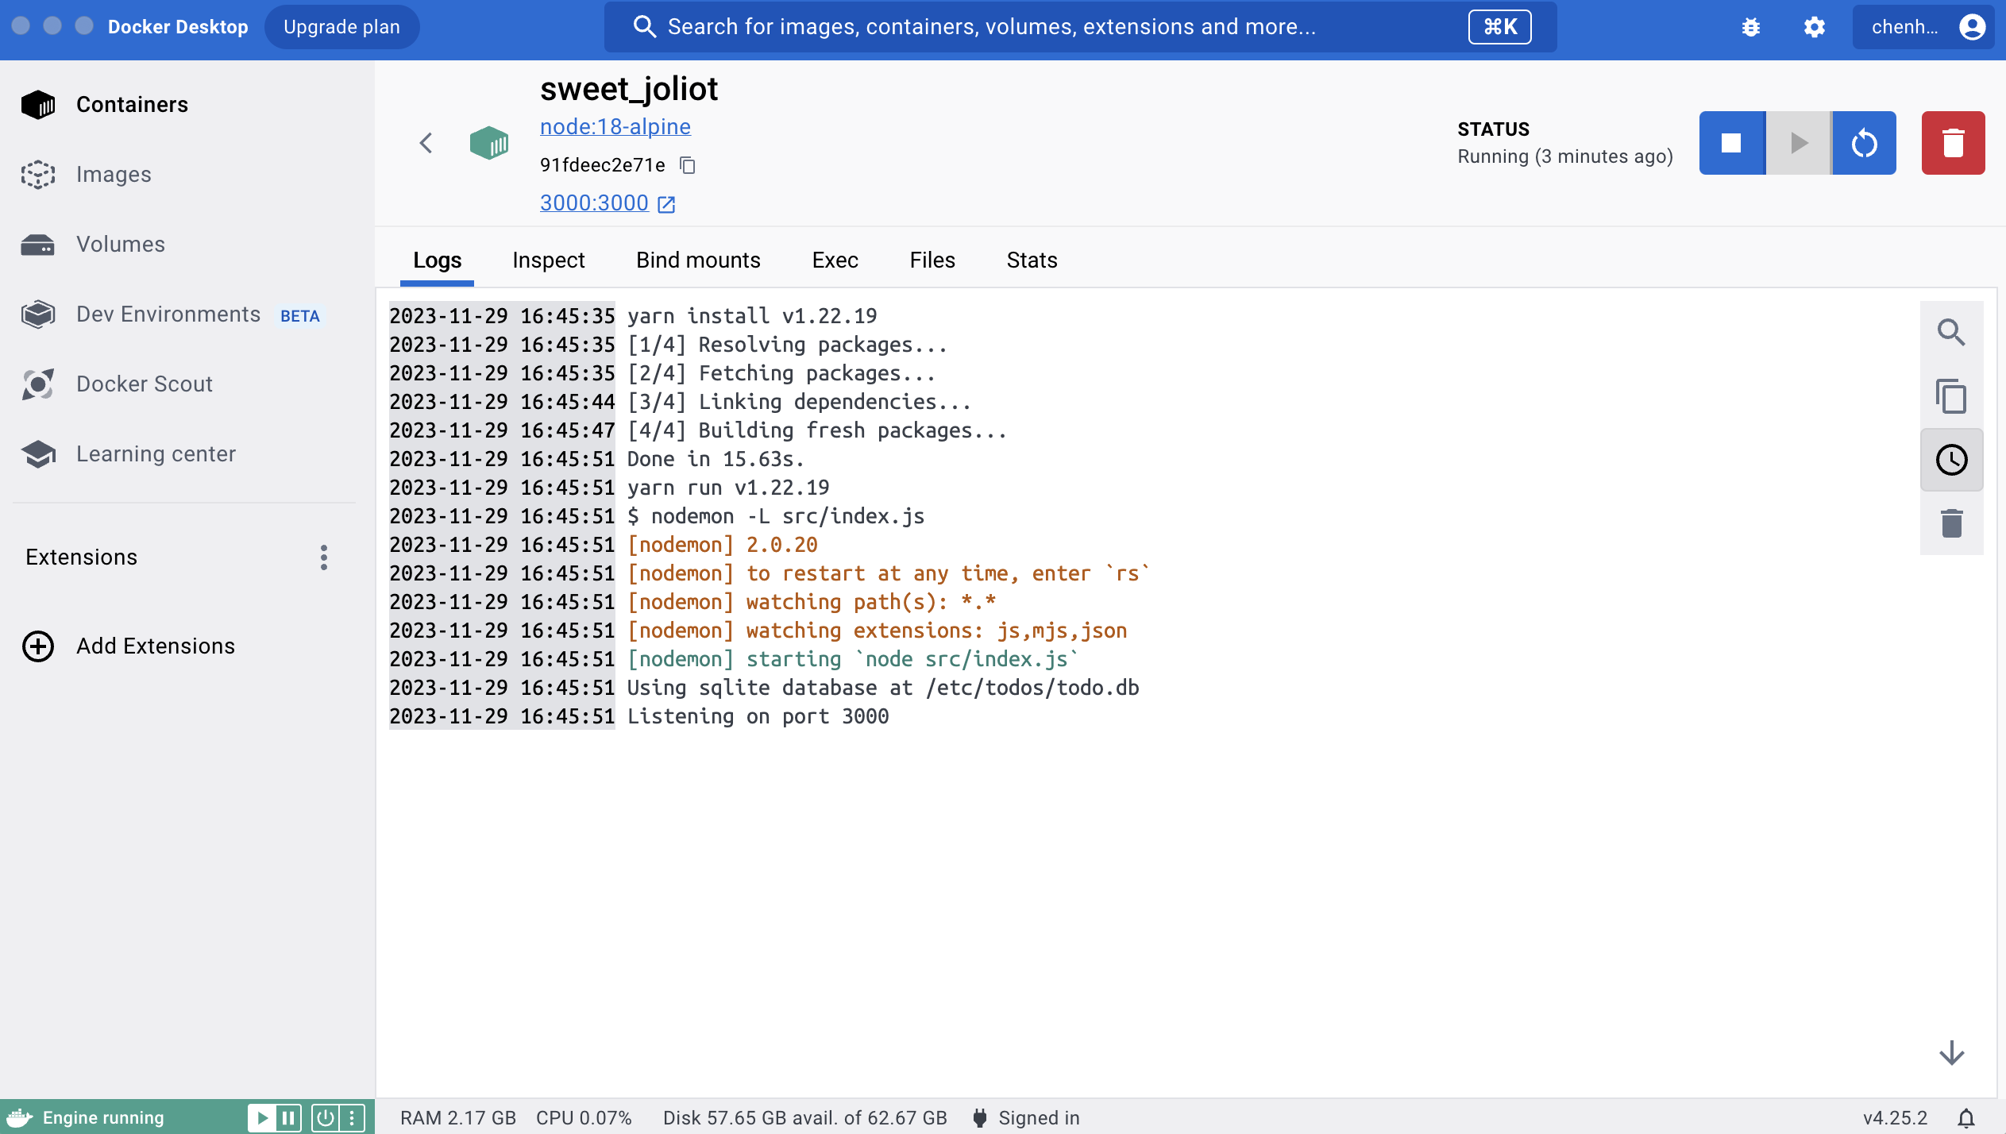
Run your app in a development container
You can watch the logs using docker logs -f <container-id>. You’ll know you’re ready to go when you see this:

Slide 31
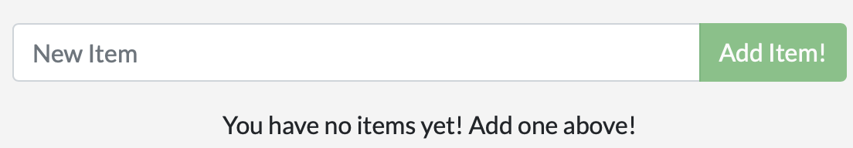
Develop your app with the development container
In the src/static/js/app.js file, let’s change the “Add Item” button to simply say “Add”.
{submitting ? 'Adding...' : 'Add Item'}
+ {submitting ? 'Adding...' : 'Add'}
Simply refresh the page (or open it) and you should see the change reflected in the browser almost immediately.
It might take a few seconds for the Node server to restart, so if you get an error, just try refreshing after a few seconds.

Slide 32
Use bind mounts
Feel free to make any other changes you’d like to make.
Each time you make a change and save a file, the change is reflected in the container because of the bind mount.
When Nodemon detects a change, it restarts the app inside the container automatically.
When you’re done, stop the container and build your new image using
docker build -t getting-started .
Using bind mounts is very common for local development setups.
The advantage is that the dev machine doesn’t need to have all of the build tools and environments installed.
With a single docker run command, the dev environment is pulled and ready to go.

Slide 33
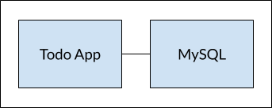
Multi container apps
In general, each container should do one thing and do it well. A few reasons:
There’s a good chance you’d have to scale APIs and front-ends differently than databases
Separate containers let you version and update versions in isolation
While you may use a container for the database locally, you may want to use a managed service for the database in production. You don’t want to ship your database engine with your app then.
Running multiple processes will require a process manager (the container only starts one process), which adds complexity to container startup/shutdown

Slide 34
Multi container apps
Container networking
Remember that containers, by default, run in isolation and don’t know anything about other processes or containers on the same machine. So, how do we allow one container to talk to another?
The answer is networking.
Note
If two containers are on the same network, they can talk to each other.
If they aren’t, they can’t.
Start MySQL
There are two ways to put a container on a network:
Assign the network when starting the container.
Connect an already running container to a network.
For now, we will create the network first and attach the MySQL container at startup.

Slide 35
Multi container apps
Start MySQL
Create the network.
$ docker network create todo-app
Start a MySQL container and attach it to the network. We’re also going to define a few environment variables that the database will use to initialize the database.
$ docker run -d \
--network todo-app --network-alias mysql \
-v todo-mysql-data:/var/lib/mysql \
-e MYSQL_ROOT_PASSWORD=secret \
-e MYSQL_DATABASE=todos \
mysql:8.0
Notes:
docker run -d --network todo-app --network-alias mysql -v todo-mysql-data:/var/lib/mysql -e MYSQL_ROOT_PASSWORD=secret -e MYSQL_DATABASE=todos mysql:5.7

Slide 36
Multi container apps
Start MySQL
To confirm we have the database up and running, connect to the database and verify it connects.
docker exec -it <mysql-container-id> mysql -u root -p
When the password prompt comes up, type in secret. In the MySQL shell, list the databases and verify you see the todos database.
mysql> SHOW DATABASES;
You should see output that looks like this:
+--------------------+
| Database |
+--------------------+
| information_schema |
| mysql |
| performance_schema |
| sys |
| todos |
+--------------------+
5 rows in set (0.00 sec)

Slide 37
Multi container apps
Connect to MySQL
We’re going to make use of the nicolaka/netshoot container,
which ships with a lot of tools that are useful for troubleshooting or debugging networking issues.
Start a new container using the nicolaka/netshoot image. Make sure to connect it to the same network.
docker run -it --network todo-app nicolaka/netshoot
Inside the container, we’re going to use the dig command, which is a useful DNS tool.
We’re going to look up the IP address for the hostname mysql.
dig mysql

Slide 38
Multi container apps
Run your app with MySQL
Specify each of the previous environment variables, as well as connect the container to your app network. Make sure that you are in the getting-started-app directory when you run this command.
docker run -dp 127.0.0.1:3000:3000 \
-w /app -v "$(pwd):/app" \
--network todo-app \
-e MYSQL_HOST=mysql \
-e MYSQL_USER=root \
-e MYSQL_PASSWORD=secret \
-e MYSQL_DB=todos \
node:18-alpine \
sh -c "yarn install && yarn run dev"

Slide 39
Multi container apps
Run your app with MySQL
If you look at the logs for the container (docker logs -f <container-id>), you should see a message similar to the following, which indicates it's using the mysql database.
$ nodemon src/index.js
[nodemon] 2.0.20
[nodemon] to restart at any time, enter `rs`
[nodemon] watching dir(s): *.*
[nodemon] starting `node src/index.js`
Connected to mysql db at host mysql
Listening on port 3000
Open the app in your browser and add a few items to your todo list.

Slide 40
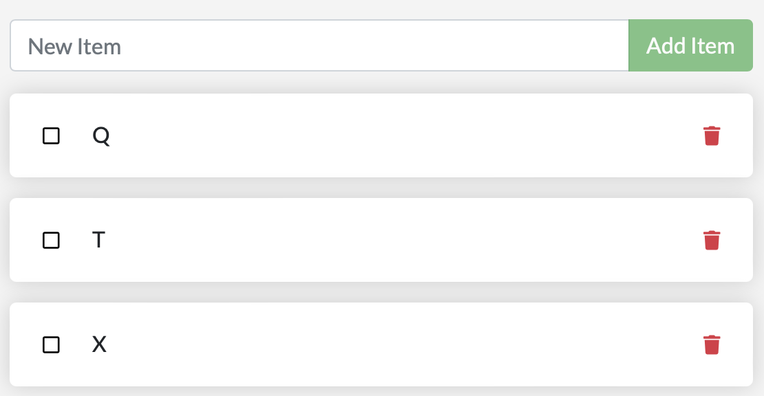
Multi container apps
Run your app with MySQL
Connect to the mysql database and prove that the items are being written to the database. Remember, the password is secret.
docker exec -it <mysql-container-id> mysql -p todos
And in the mysql shell, run the following:
mysql> select * from todo_items;
+--------------------------------------+------+-----------+
| id | name | completed |
+--------------------------------------+------+-----------+
| 6a3b7b71-895e-4d51-9096-86d9f4519bfb | Q | 0 |
| 3264e7fe-30e3-4dbc-b185-c448ad2b1727 | T | 0 |
| daa776a5-263e-4130-8c0e-56d79f0e3372 | X | 0 |
+--------------------------------------+------+-----------+
3 rows in set (0.00 sec)

Slide 41
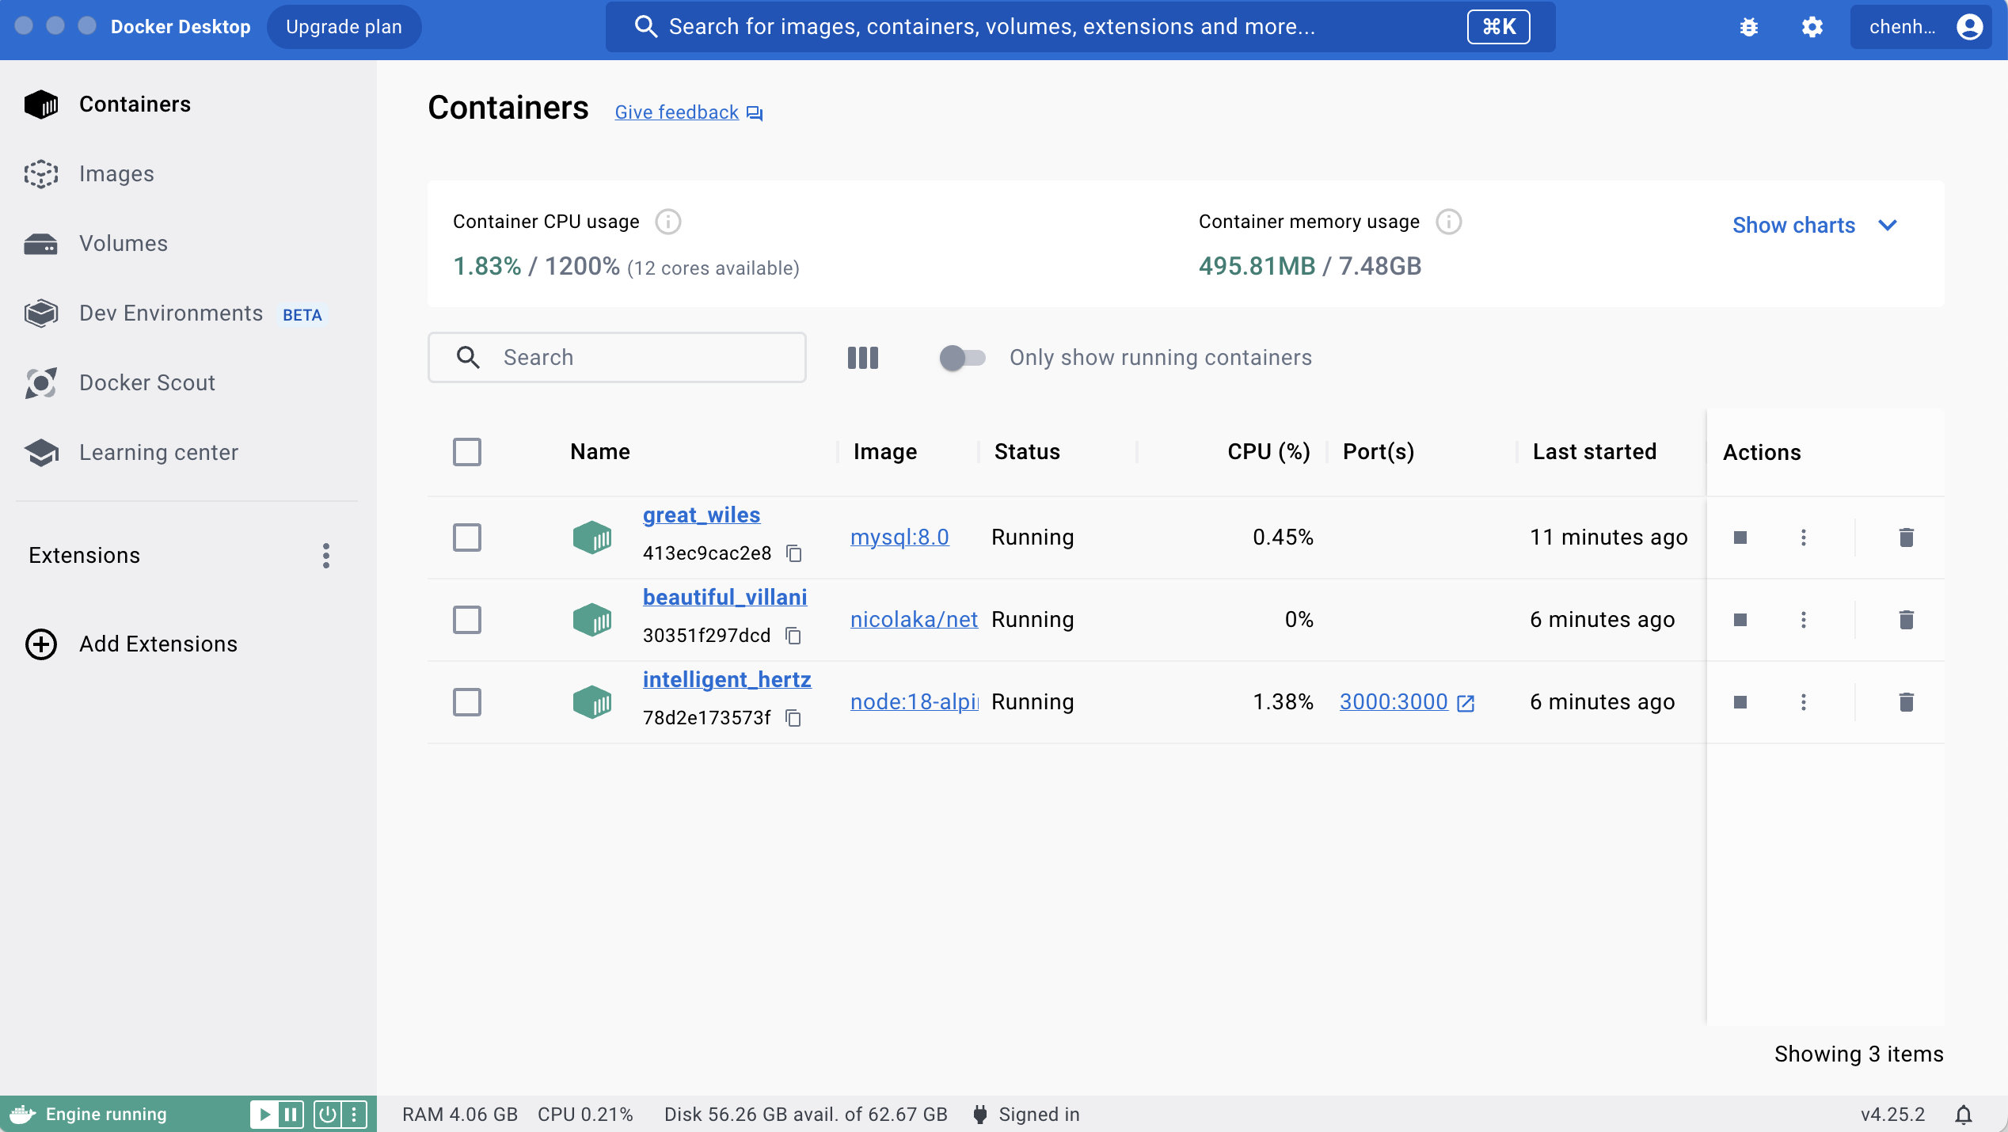
Multi container apps
Run your app with MySQL

Slide 42
Use Docker Compose
Docker Compose is a tool that helps you define and share multi-container applications.
With Compose, we can create a YAML file to define the services and with a single command, can spin everything up or tear it all down.
The big advantage of using Compose is
you can define your application stack in a file, keep it at the root of your project repo (it’s now version controlled), and easily enable someone else to contribute to your project.
Someone would only need to clone your repo and start the compose app. In fact, you might see quite a few projects on GitHub/GitLab doing exactly this now.

Slide 43
Use Docker Compose
Create the Compose file
At the root of the app project, create a file named compose.yaml.
Define the app service – define the service in the compose.yaml file
services:
app:
image: node:18-alpine
command: sh -c "yarn install && yarn run dev"
ports:
- 127.0.0.1:3000:3000
working_dir: /app
volumes:
- ./:/app
environment:
MYSQL_HOST: mysql
MYSQL_USER: root
MYSQL_PASSWORD: secret
MYSQL_DB: todos

Slide 44
Use Docker Compose
Define the MySQL service
services:
app:
# The app service definition
mysql:
image: mysql:8.0
volumes:
- todo-mysql-data:/var/lib/mysql
environment:
MYSQL_ROOT_PASSWORD: secret
MYSQL_DATABASE: todos
volumes:
todo-mysql-data:

Slide 45
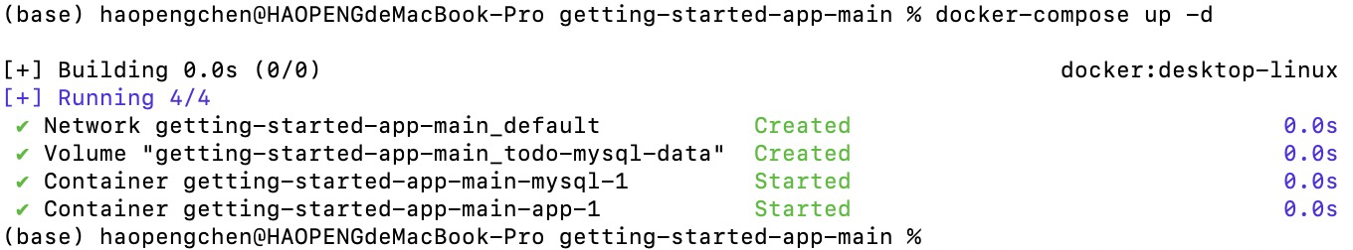
Use Docker Compose
Run the application stack
docker-compose up -d

Slide 46
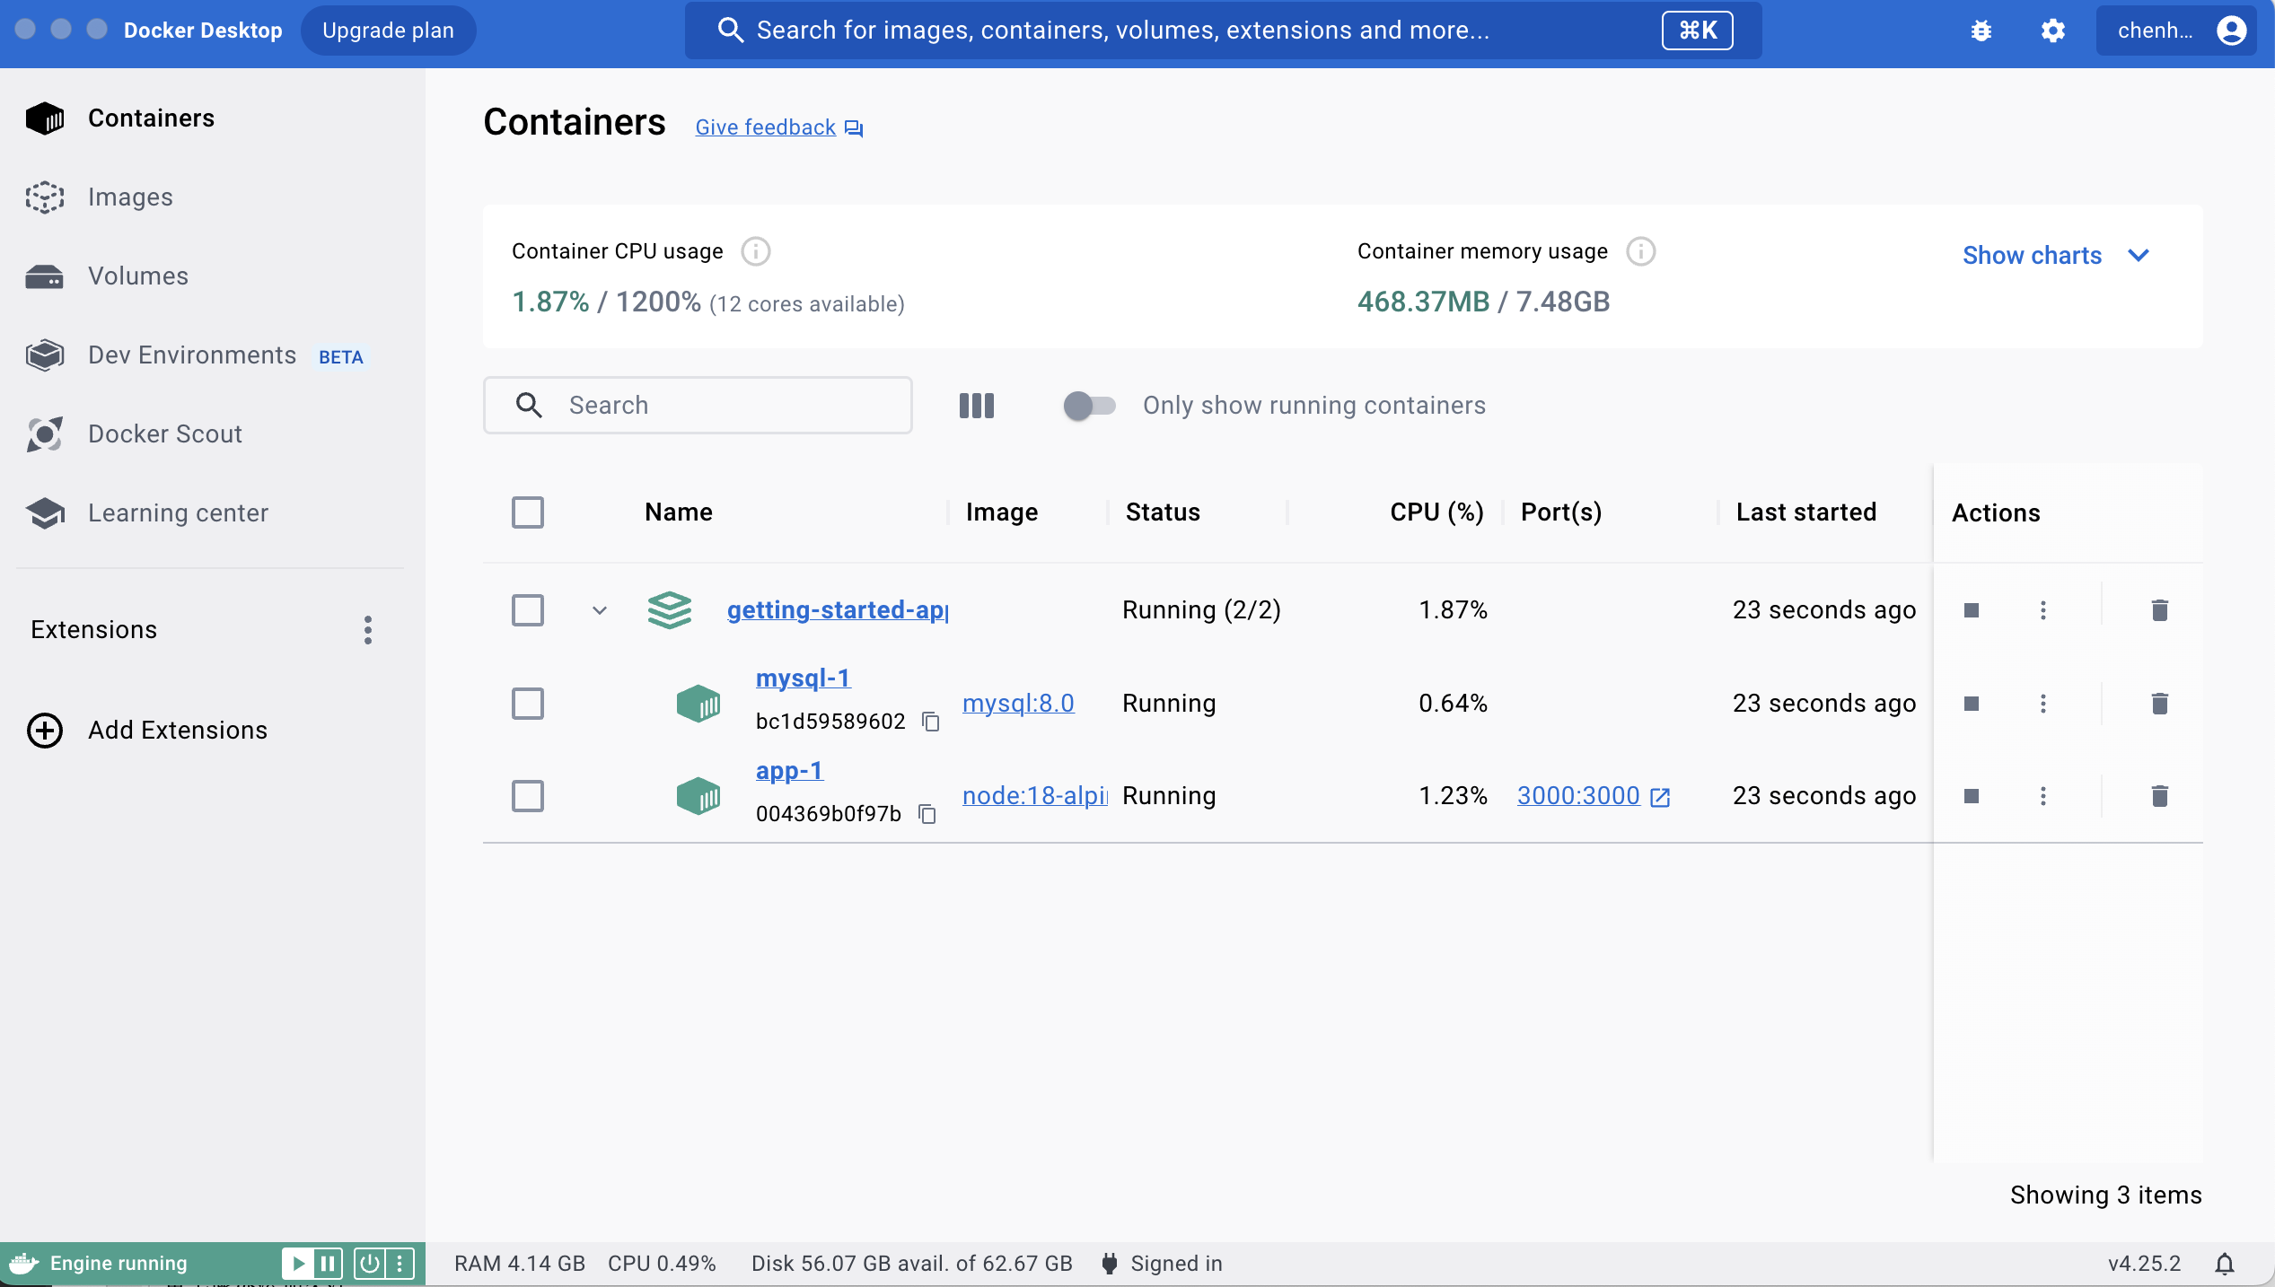
Use Docker Compose
Run the application stack
docker-compose up -d

Slide 47
Docker in IntelliJ IDEA
From:
https://www.jetbrains.com/help/idea/docker.html
IntelliJ IDEA integrates the Docker functionality and provides assistance for creating Docker images, running Docker containers, managing Docker Compose applications, using public and private Docker registries, and much more directly from the IDE.
Enable the Docker plugin
Press ⌘Сmd, to open the IDE settings and then select Plugins.
Open the Installed tab, find the Docker plugin, and select the checkbox next to the plugin name.

Slide 48
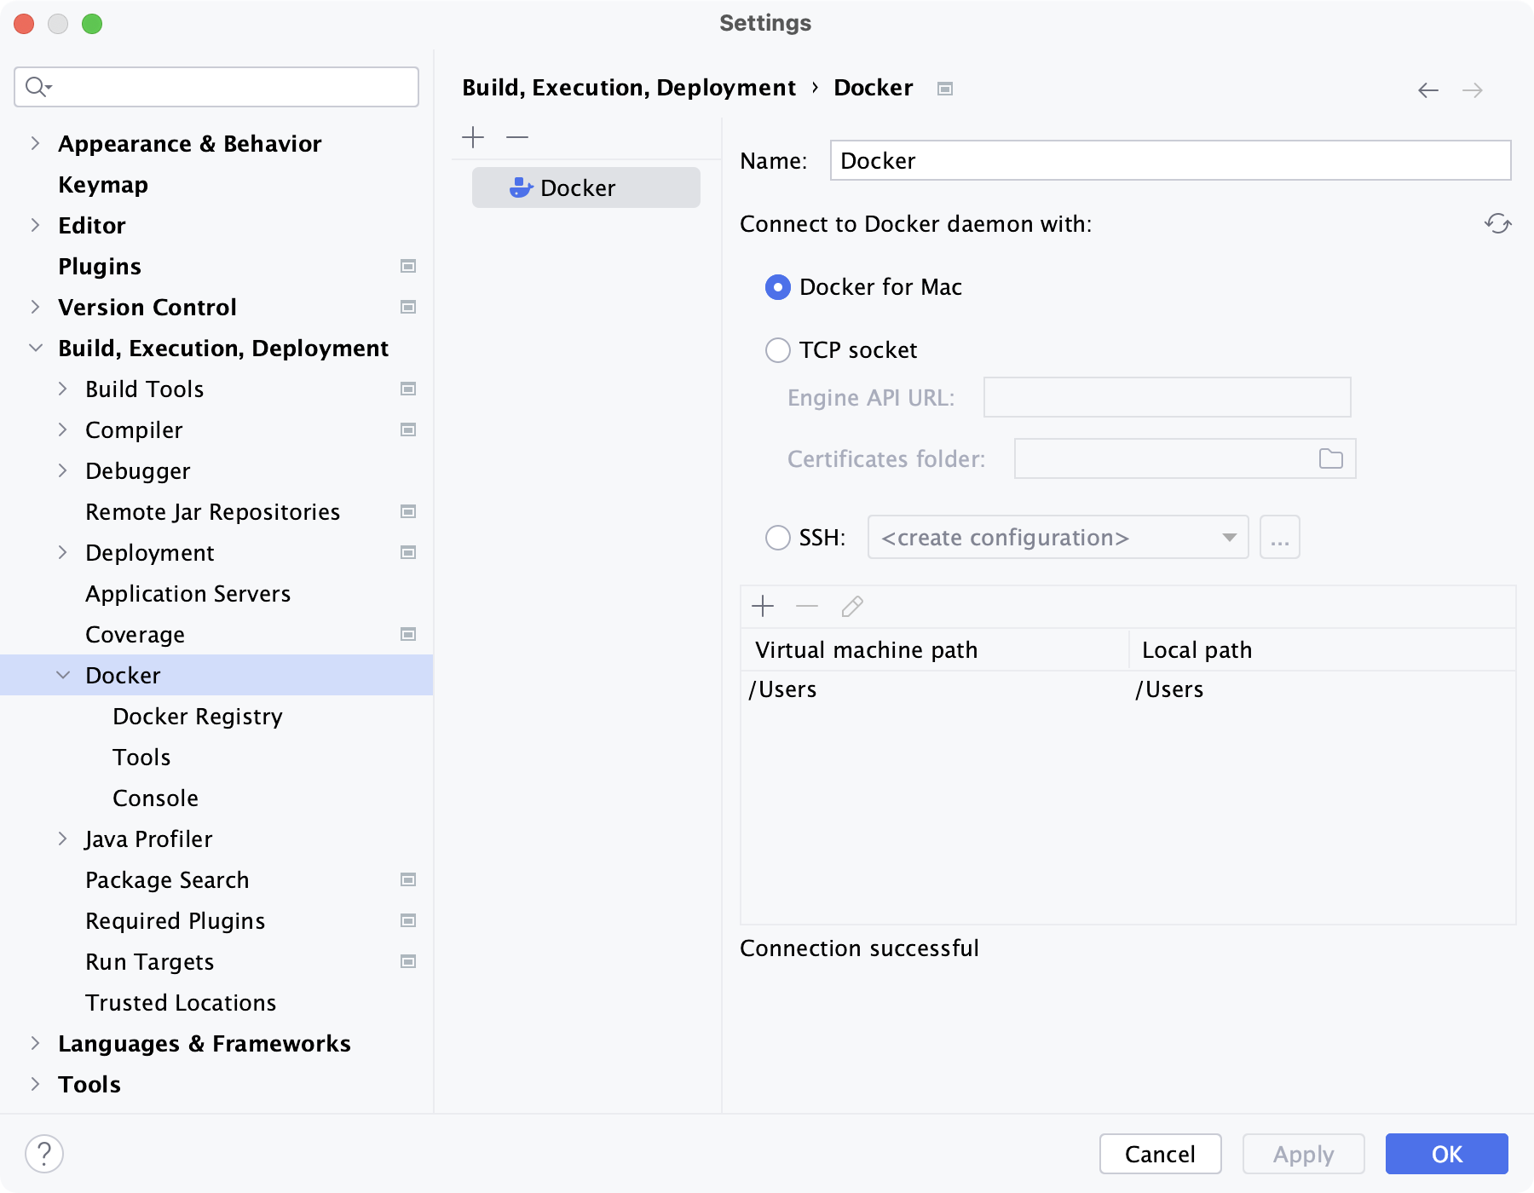
Docker in IntelliJ IDEA
Connect to the Docker daemon

Slide 49
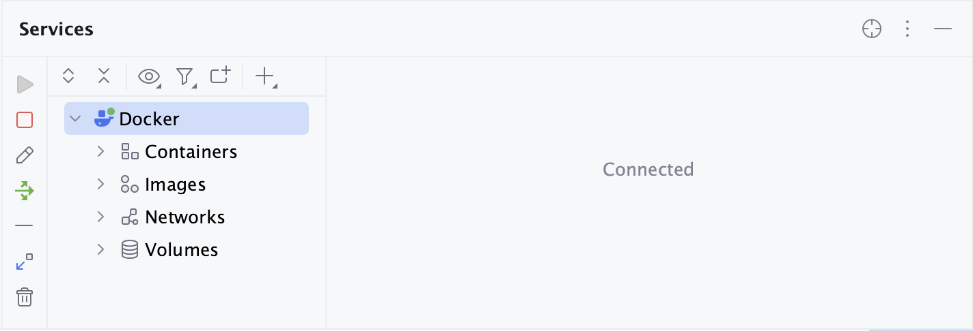
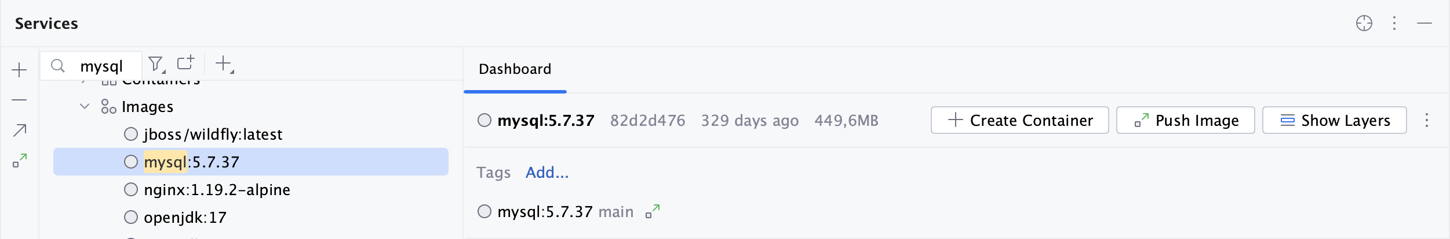
Docker in IntelliJ IDEA
Connect to the Docker daemon

Slide 50
Run Spring Boot Application in Docker
Greeting.java
@RestController public class Greeting { @GetMapping("/greeting") public String greeting(){ return "Hello World!"; } }
Se335323DockerwebsampleApplication.java
@SpringBootApplication public class Se335323DockerwebsampleApplication { public static void main(String[] args) { SpringApplication.run(Se335323DockerwebsampleApplication.class, args); } }

Slide 51
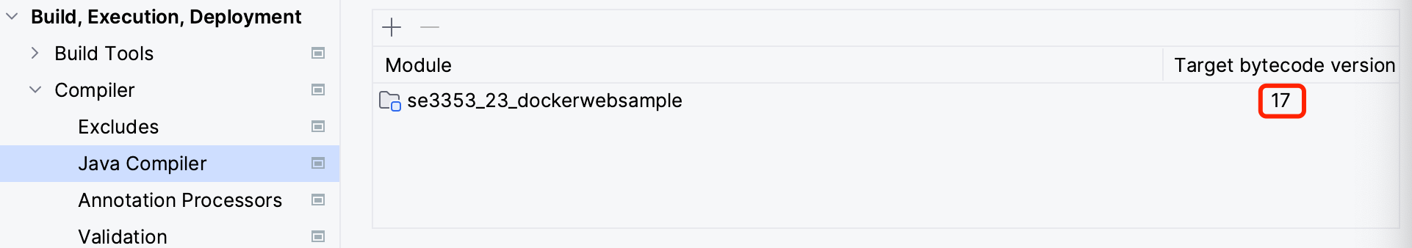
Run Spring Boot Application in Docker
pom.xml
<properties> <java.version>17</java.version> </properties>
<plugin> <groupId>org.springframework.boot</groupId> <artifactId>spring-boot-maven-plugin</artifactId> <configuration> <image> <env> <BP_JVM_VERSION>${java.version}</BP_JVM_VERSION> </env> </image> </configuration> </plugin>

Slide 52
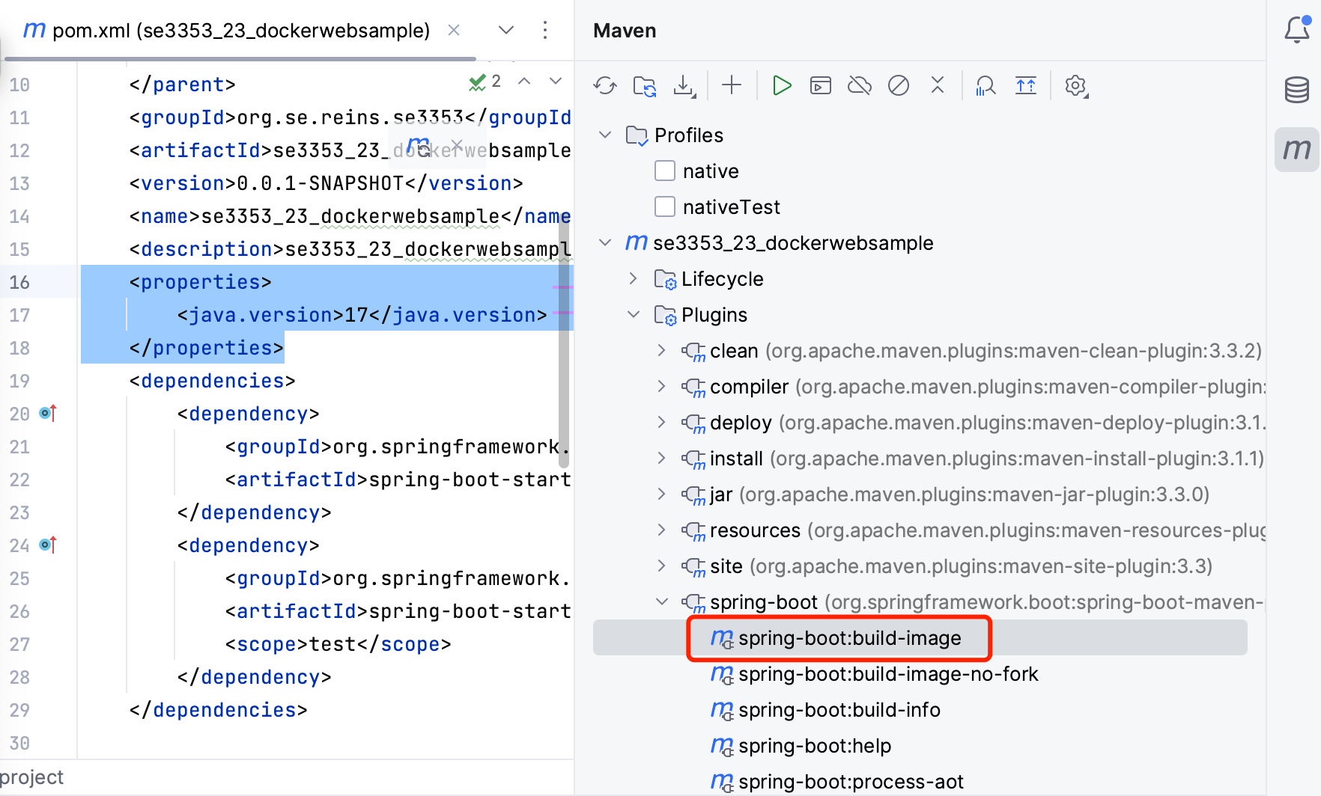
Run Spring Boot Application in Docker
Build image

Slide 53
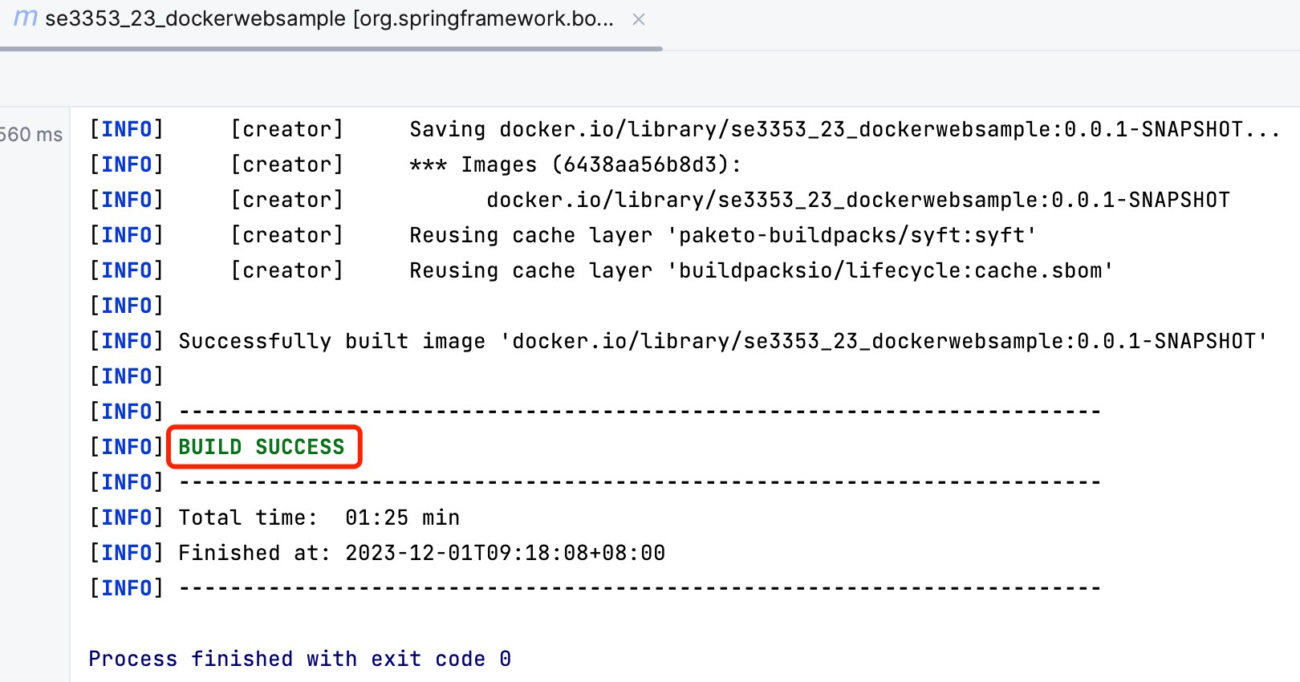
Run Spring Boot Application in Docker
Build image

Slide 54
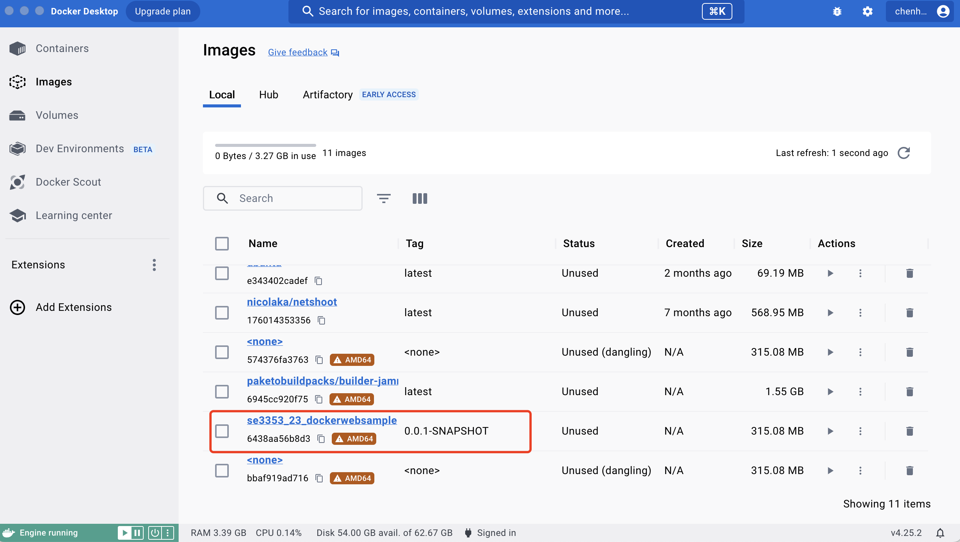
Run Spring Boot Application in Docker
Build image

Slide 55
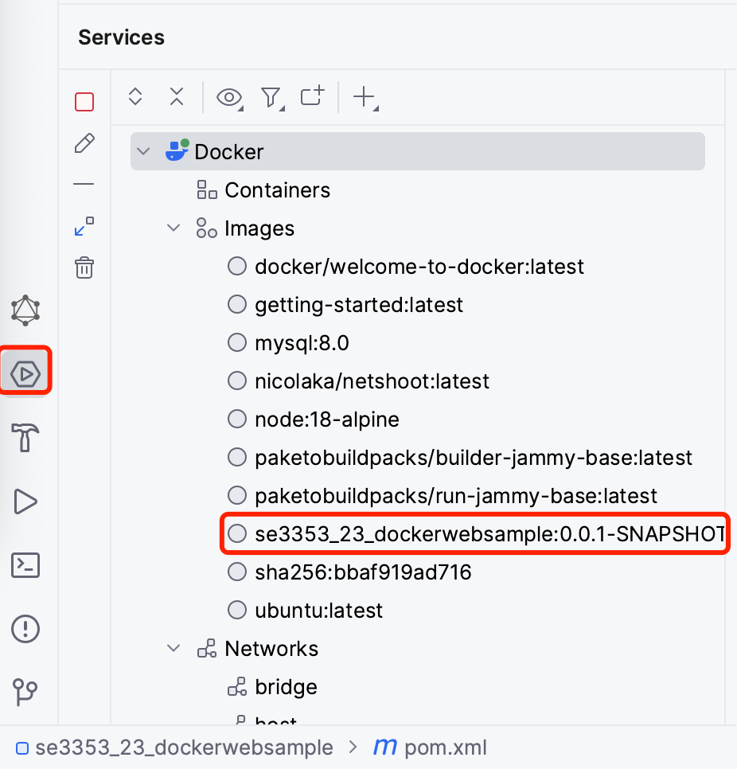
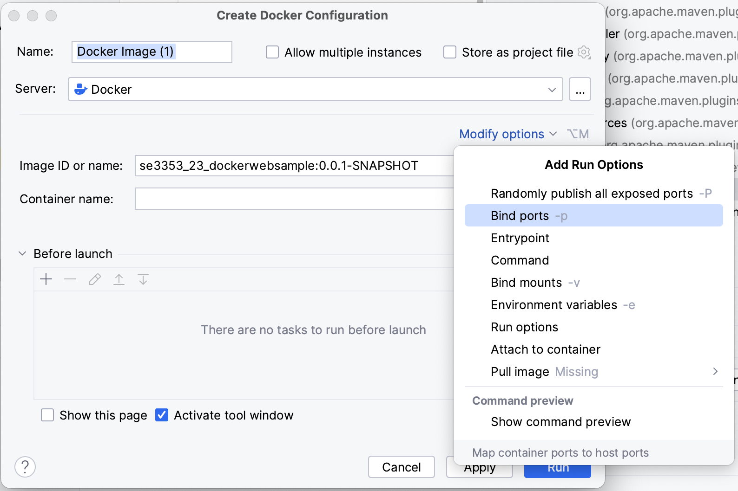
Run Spring Boot Application in Docker
Create a container

Slide 56
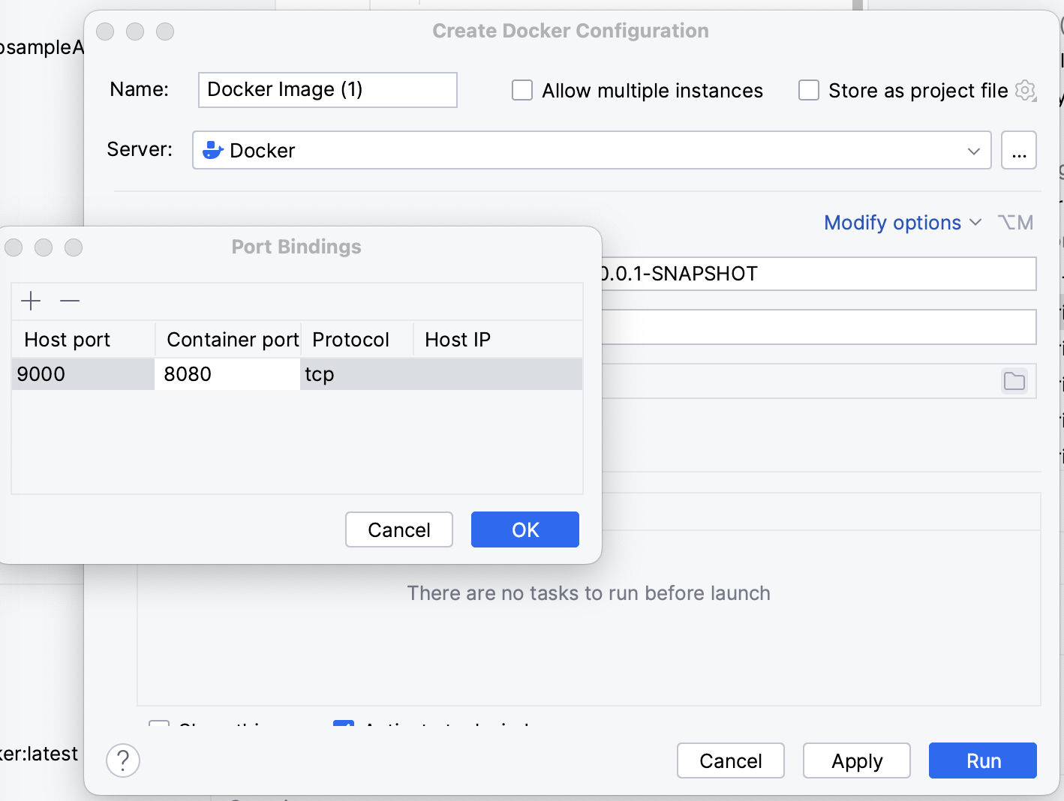
Run Spring Boot Application in Docker
Create a container

Slide 57
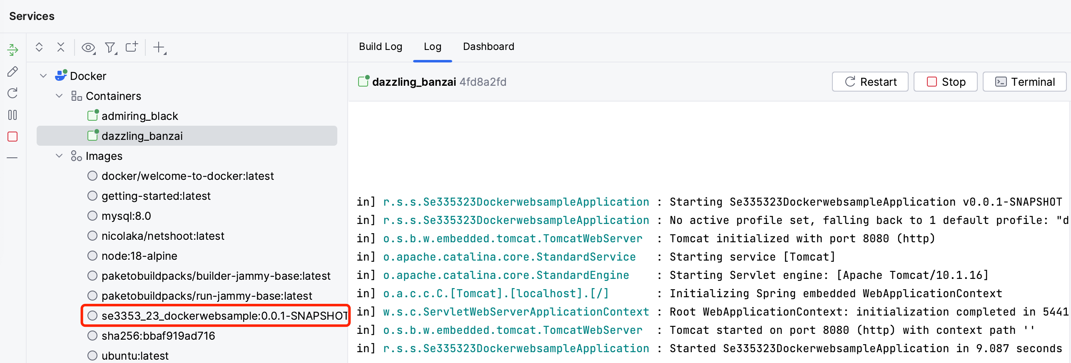
Run Spring Boot Application in Docker
Create a container

Slide 58
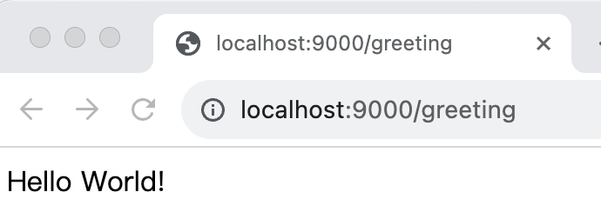
Run Spring Boot Application in Docker
Create a container

Slide 59

Thank You!

